Slide 1
WHAT'S THE MATTER?
AT THE DOCTOR
Presented by Nauczyciel Na Miarę
Katarzyna Paciorek

Slide 2
WHAT'S THE MATTER?

Slide 3
WHAT'S THE MATTER?

Slide 4
WHAT'S THE MATTER?

Slide 5
WHAT'S THE MATTER?

Slide 6
WHAT'S THE MATTER?

Slide 7
WHAT'S THE MATTER?

Slide 8
WHAT'S THE MATTER?

Slide 9
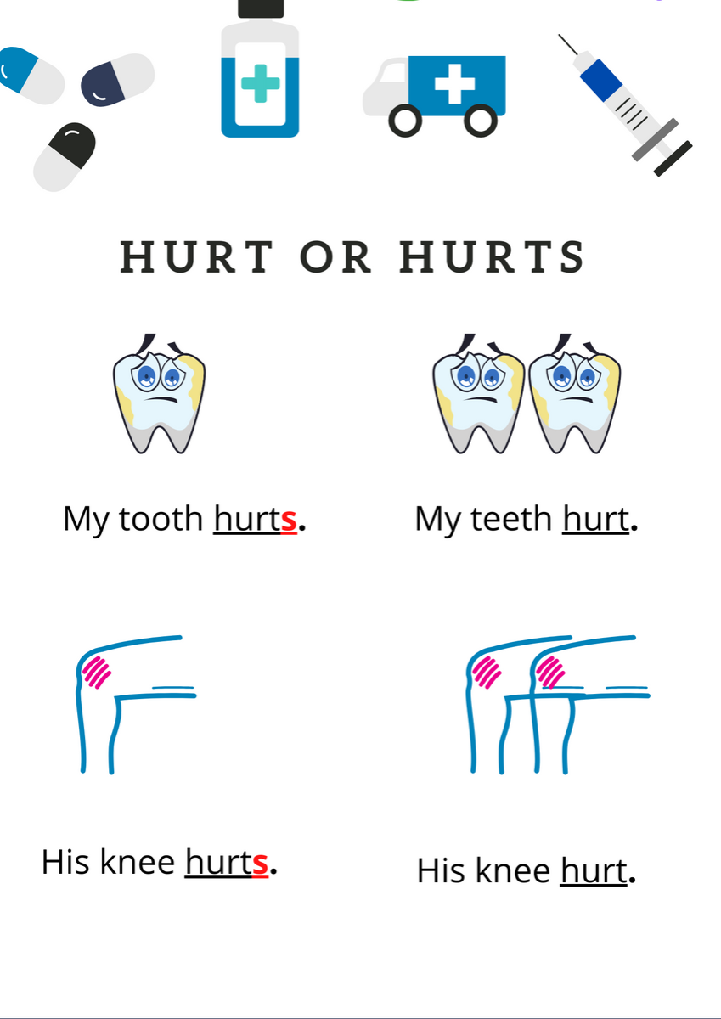
WHAT'S THE MATTER?

